Slide 1
中国的麦当劳 （词汇）
CLTA – Startalk
K – 5th grade Training Model

Slide 2
Part I
Introduce the new characters

Slide 3
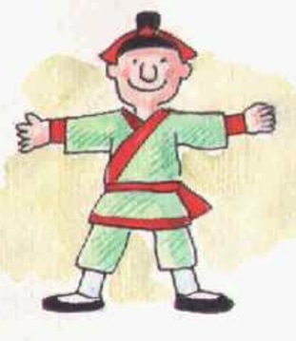
大

Slide 4
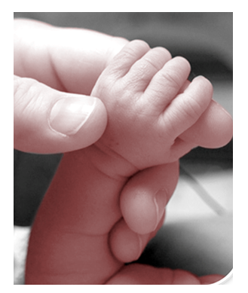
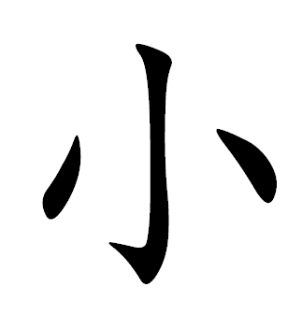

Slide 5
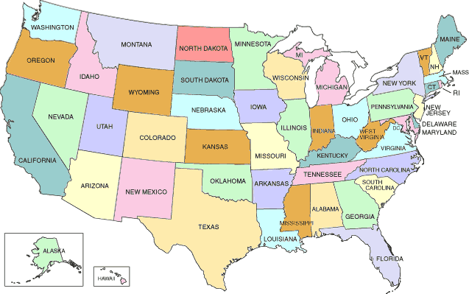
美
Guó

Slide 6
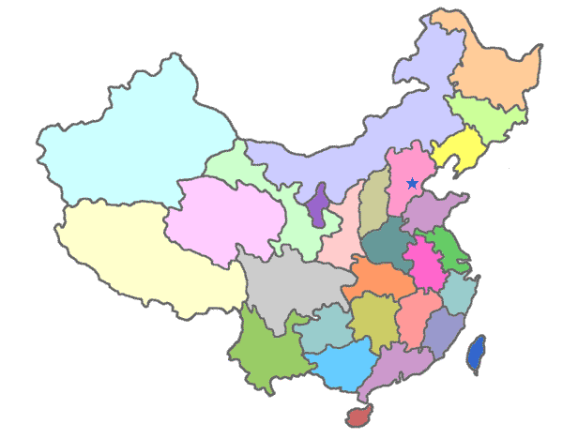
中
Guó

Slide 7
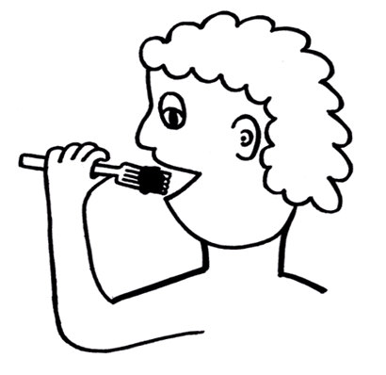
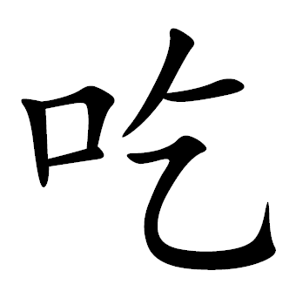

Slide 9
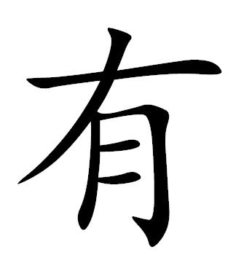
Have / has / had

Slide 10
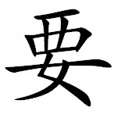
Want

Slide 11
Part II
Review the Chinese characters and PinYin

Slide 12
大
dà

Slide 13
xiǎo

Slide 14
美guó
měi guó

Slide 15
中guó
zhōng guó

Slide 16
chī

Slide 17
hē

Slide 18
yǒu
Have / has / had

Slide 19
yào
Want

Slide 20
Part III
How many character do you remember?

Slide 21
美guó
měi guó

Slide 22
大
dà

Slide 23
yǒu
Have / has / had

Slide 24
中guó
zhōng guó

Slide 25
chī

Slide 26
yào
Want

Slide 27
xiǎo

Slide 28
hē

Slide 29
Chinese Character
Wheel Game

Slide 30
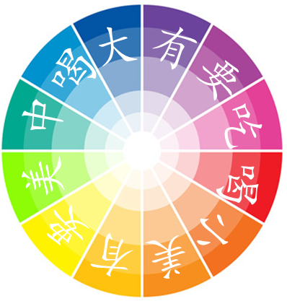
Chinese Character Game
Read Loud
Please click the wheel and spin !!!

